Slide 1
ZEGA’s Dividend Max Strategy
February 2026

Slide 2
Disclosure
Information presented does not involve the rendering of personalized investment advice, but is limited to the dissemination of general information on products and services. This information should not be construed as an offer to buy or sell, or a solicitation of any offer to buy or sell the securities mentioned herein.
This presentation should not be regarded as a complete analysis of the subjects discussed. All expressions of opinion reflect the judgment of the adviser as of the date of the presentation and are subject to change.
Past performance may not be indicative of future results. Therefore, no current or prospective client should assume that the future performance of any specific investment or strategy will be profitable or equal to past performance levels. All investment strategies have the potential for profit or loss. Different types of investments involve varying degrees of risk, and there can be no assurance that any specific investment or strategy will be suitable or profitable for a client's portfolio. There are no assurances that a portfolio will match or outperform any particular benchmark.
ZEGA Investments claims compliance with the Global Investment Performance Standards (GIPS®) and has prepared and presented this report in compliance with the GIPS standards. ZEGA has not been independently verified.
Except where specifically identified otherwise, all performance data in this presentation is the performance of the Separate Account Strategy.

Slide 3
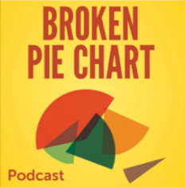






About ZEGA Investments LLC
“ZEGA partners with advisors to deliver options-based solutions that clearly define and align potential returns with an individual client’s risk profile.
We combine over 140 years of trading experience with our passion to develop forward-thinking strategies that distinguish both our firm…and yours.
Never forgetting our adherence to the strictest of ethical codes.”
Jay Pestrichelli, Founder & Executive Chairman
ZEGA Investments - SEC Registered Investment Advisor effective 2024 Originally part of ZEGA Financial Founded in 2011
ZEGA Investments AUM ~$500M+ as of 12/31/24.
Conservative market positioning that encompasses hedged equity, alternative income, alpha generation and more
Authors of the best-seller¹ on hedged equity: “Buy and Hedge: The 5 Iron Rules for Investing over the Long Term”
Established as a source for option insights on numerous financial media
Host of the “Broken Pie Chart Podcast”
1 Appeared on Amazon best-seller list for ‘Investing’ category upon release January 2011
Registration as an investment advisor does not constitute an endorsement of the firm by the SEC or any other securities regulator and does not mean the advisor has attained a particular level of skill or ability

Slide 4
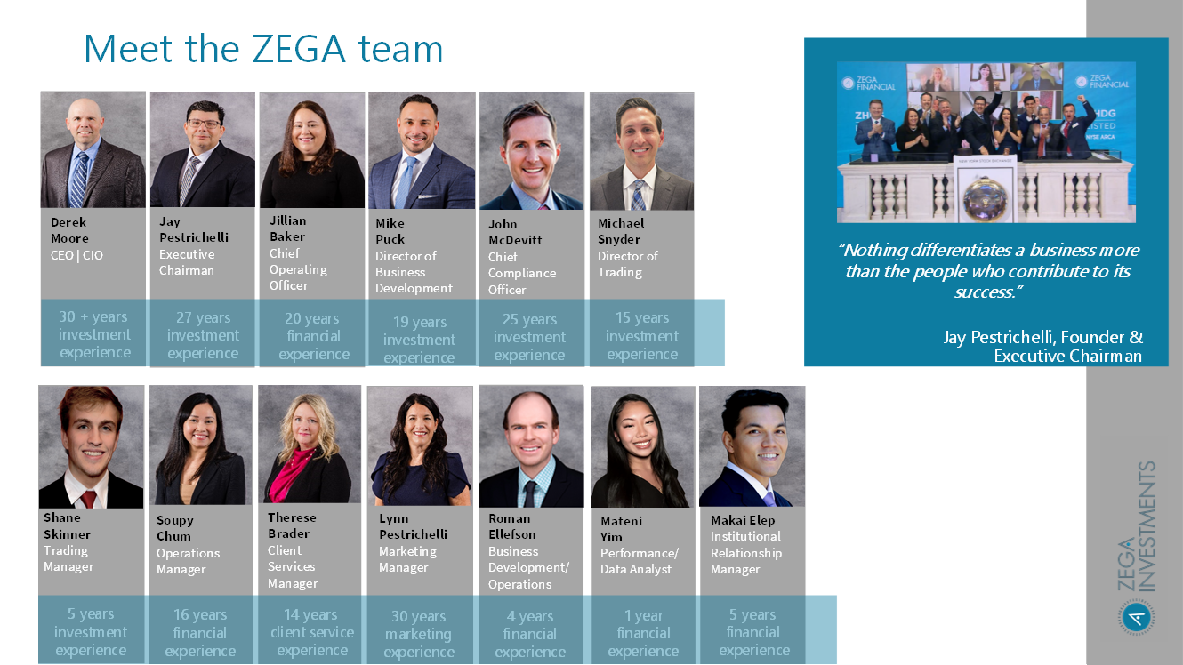

Slide 5
Dividend Max – Basket of ETFs for Alt Income
Actively managed Basket of ETFs constructed with options on a single ticker with the intention of delivering outsized dividend yields.
Strategy designed to convert option volatility to cash flow
Using short-term and near-the-money option selling, Puts, Calls or Spreads. The strategy looks to take advantage of the natural time decay of options
Some positions may use a replication of a covered call strategy.

Slide 6
A review of Covered Calls
Sell call
Sell call
Sell call
Sell call
Open
position

Slide 7
Portfolio Composition of ETFs
Synthetic Covered
Call
Short Put + Long Call = Long Stock Position
Short Call = Income
Treasuries = Collateral & Additional Income
Results:
Covered call strategy
Monthly income potential
Short out-of-the money call allows some upside participation
All options are backed by the Options Clearing Corporation (OCC)
No leverage
No stock gets called away

Slide 8
Target Yield of:
ETF Dividend Max
Dividend Max : Holds high dividend yielding ETFs that primarily institute synthetic covered calls, covered call strategies or other options tactics.
Funds generate income from a combination of selling covered call premium and any available capital appreciation
Diversify Across Stocks, Commodities and Bonds
High Income Focused
up to
30%+
Profit/loss
Risks
Portfolio should move inline with a 70/30 portfolio or a 90/10 portfolio
The covered call ETFs are not downside protected
Some of the ETFs are invested in tech stocks, tech stocks can be more volatile than the S&P500 at times
If the portfolio uses margin, the fluctuation in value will magnify by the percentage of leverages used. For example, a portfolio with 50% margin balance will fluctuate 100% more than a non-margined account
Market change

Slide 9
Use Case: ETF Build Enhancement
Adding a slice of income to an ETF build
 | Allocation | Yield | Volatility
ETF Dividend Build | 100% | 4% | 20%
ETF Dividend Build | 75% | 4% | 20%
ZEGA ETF Dividend Max | 25% | 35%* | 50%**
Weighted Result |  | 11.75% | 24.5%
*Assuming 50% Yield (Target)
**Assuming Volatility of 30%
For clients who can handle the increase in volatility, the dividend can almost triple with a 25% Dividend Max allocation

Slide 10
ZEGA ETF Dividend Max Summary
High Income Focus
Dividend yield is different than Total Return
ETFs carry same downside risk of stocks, minus options premium
Diversify Across Stocks, Commodities and Bonds
Strategy does not need options or margin approval
Strategy can be run in UMA or SMA format

Slide 11
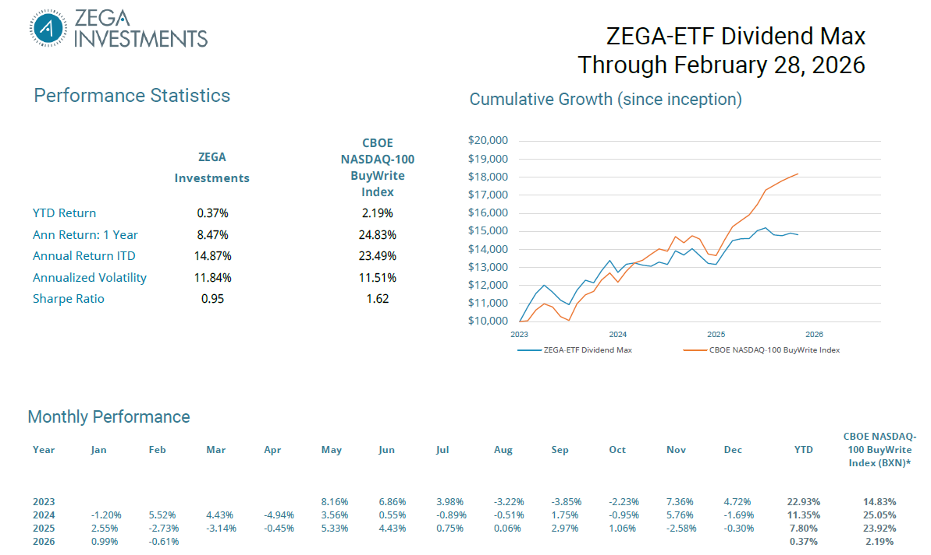

Slide 12

For more information – including short videos, podcasts, blog posts – on the entire family of ZEGA strategies:
ZEGAInvestments.com
Service@ZEGAInvestments.com (email)

