Slide 1

December 2025
3 Slides, 3 Minutes
Prepared for Mark & Kim Huffstutler
Doug Greenberg President 503-880-1828 doug@pnwadvisory.com

Slide 2
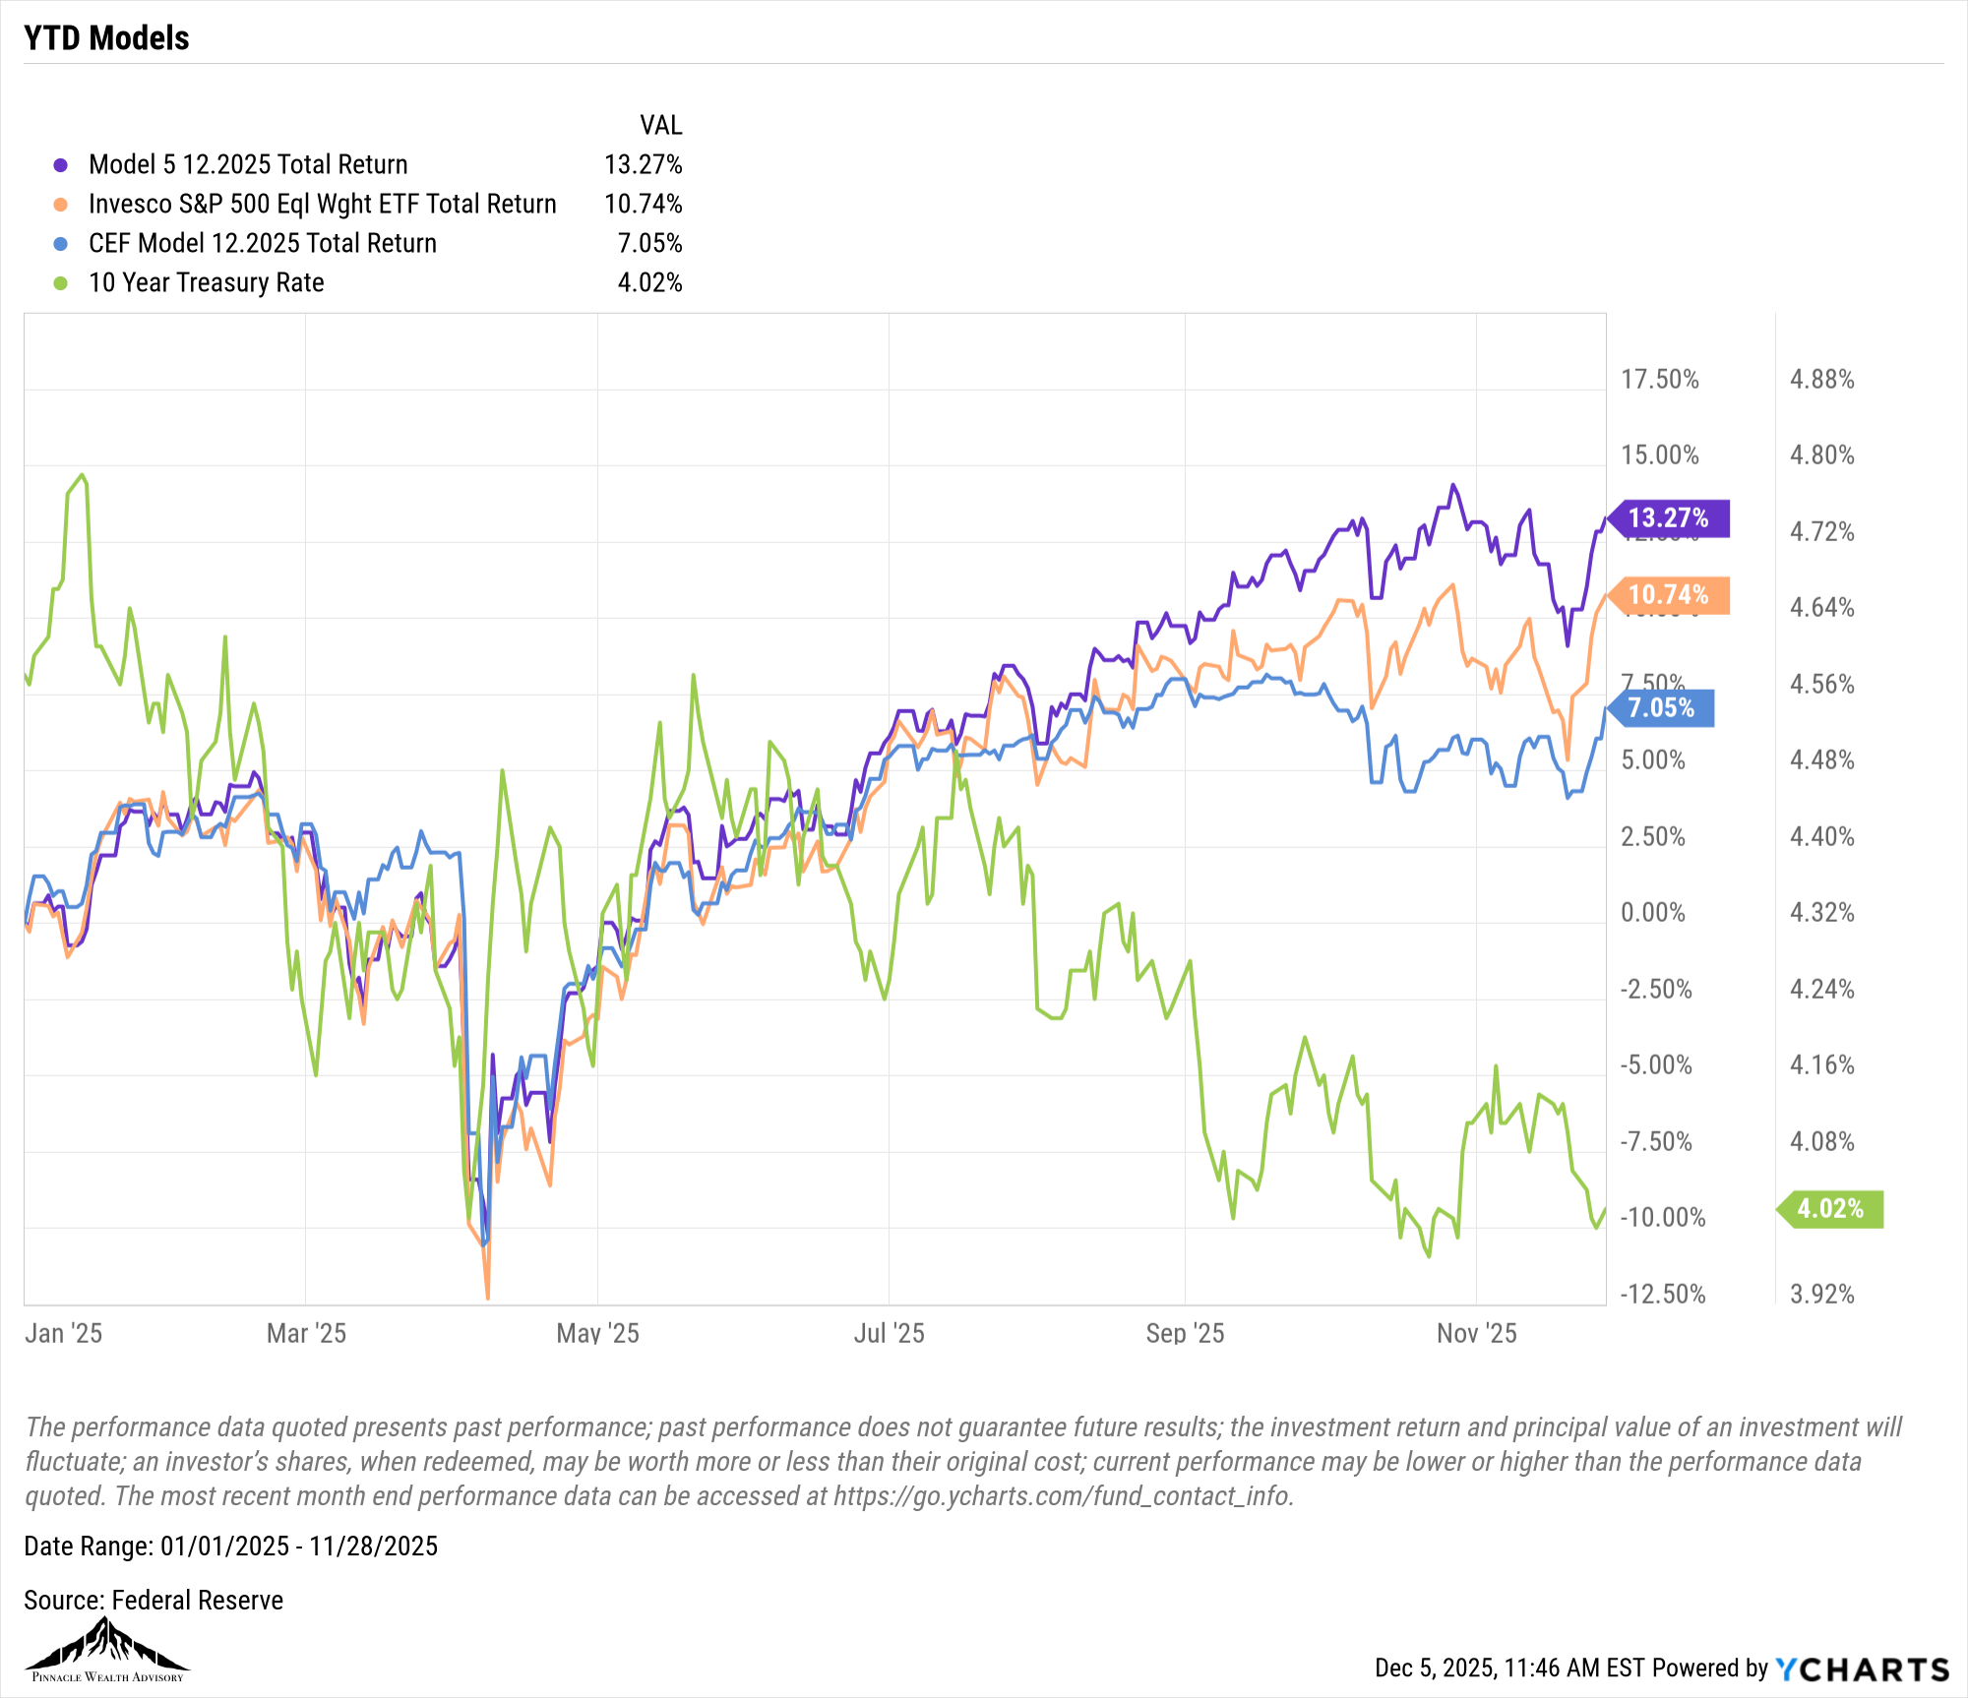
Year-to-Date Model Portfolio Returns – Nov 28, 2025
Notes:
So far in 2025, the market’s been like a fast car with a nervous driver—quick moves, but always checking the mirrors. Tech stocks have led the way again, especially anything tied to AI. The Fed hit pause on raising interest rates, which gave investors some breathing room. Bonds quietly came back into the picture. And regular people—retail investors—are still showing up and making an impact. But here’s the thing: when you zoom out and look at the chart, one thing becomes clear. Staying invested through the ups and downs actually works. Early in the year, things dropped fast. Then they recovered, then built momentum. That’s how real investing feels. It’s not perfect, and it’s never smooth. But by November, most models were positive—and some beat the overall market. The takeaway? You don’t have to guess the perfect day to buy or sell. What you need is a plan you trust, and the discipline to stick with it. That’s how you grow money over time.

Slide 3
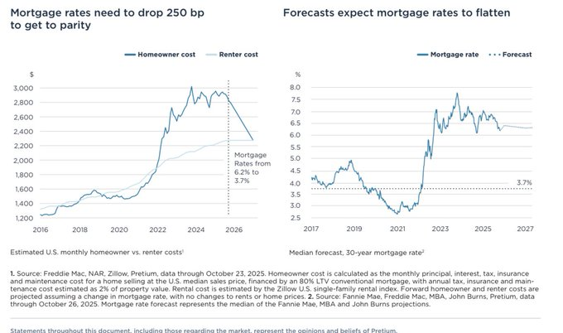
Renting vs Buying
Notes:
More families in the U.S. are renting homes instead of buying right now. Why? Because it’s simply cheaper. A company called Pretium ran the numbers and found that for buying a home to make sense again, mortgage rates would need to drop from about 6.2% to 3.7%. That’s a big shift. Until then, renting is the better deal for a lot of people. Imagine you’re comparing two paths: one leads to a monthly payment that’s manageable, the other costs a lot more just to say you “own” the place. That extra cost doesn’t always make financial sense. What I tell people—whether they’re students or business owners—is to look at the math first. Emotion shouldn’t drive the decision. The goal is to build stability, not just chase what sounds good.

Slide 4
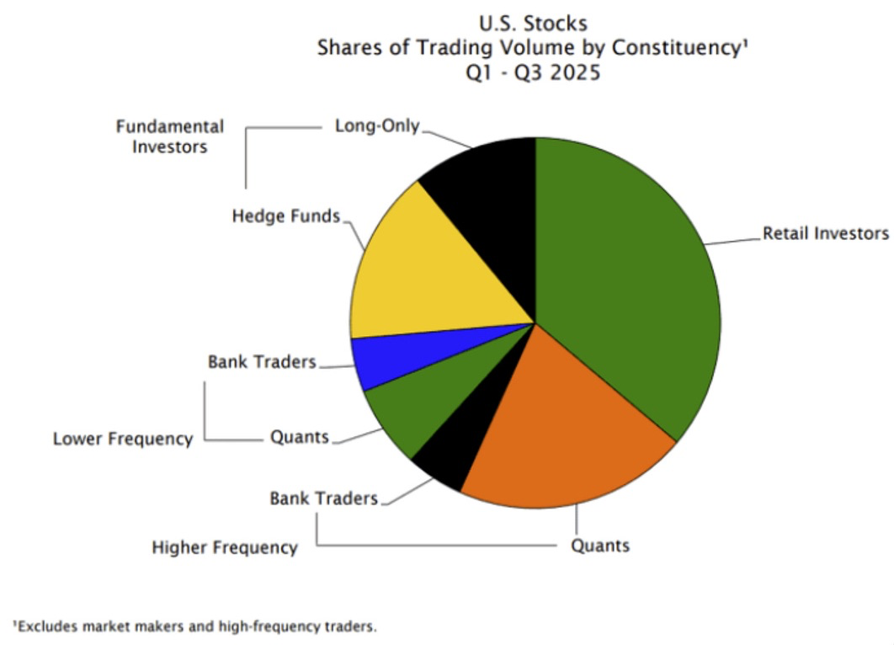
Who Does the Volume?
Source: Empirical Research Partners
Notes:
So, who’s doing all the buying and selling in the U.S. stock market? Turns out, regular people—retail investors—actually drive most of the volume. On the institutional side, it’s split: about half are using computer models (quants), and the other half are doing traditional research, picking stocks one by one. You’ve also got half the volume happening really fast—milliseconds—and the other half more long-term. What does that mean? Retail investors are in charge of the tempo. Quants are off running their algorithms, and old-school investors—the Warren Buffett types—are kind of in the minority. That’s not surprising in a market that feels like it’s booming in certain sectors. But it’s a reminder: if you’re investing right now, know who’s in the room with you. And don’t chase what you don’t understand.

Slide 5

Doug Greenberg 503-880-1828 doug@pnwadvisory.com
All communication is subject to review and monitoring. Your financial professional may provide services and conduct business as Pinnacle Wealth Advisory. However, advisory services are offered through SB Advisory, LLC. Investing involves risk and past performance is no guarantee of future results. This email may contain information that may be confidential and is solely intended for the use of the intended recipient. If you are not the intended recipient, be advised that any disclosure, copy, distribution, or use of the contents of this communication is prohibited. If you have received this communication in error, please notify sender and delete the material from your computer. The information contained in this deck is market commentary for informational and educational purposes only and not an offer of advisory services. This is not an offer to buy or sell any securities and is not a recommendation regarding any investment or investment strategy. This content contains data and information from multiple third-party sources (cited). Although PNWA only displays information from sources it believes to be accurate, this information is subject to change. Please confirm directly with the source for the most up-to-date data and information.
YCharts, Inc. (“YCharts”) is not registered with the U.S. Securities and Exchange Commission (or with the securities regulatory authority or body of any state or any other jurisdiction) as an investment adviser, broker-dealer or in any other capacity, and does not purport to provide investment advice or make investment recommendations by or through the content (the “Content”) found on ycharts.com (the “Site”) or otherwise. The Site and the Content are provided for the sole purpose of enabling users to conduct investment research. Other uses of the Site and the Content are expressly prohibited.

